Slide 1
Lecture : Hashing
Hashing
1

Slide 2
Primary vs. Secondary Data Structures
Data Structures | Purpose | Examples
Primary | Provides the basic means of organizing and storing data. They are directly supported at the language level. | • arrays • linked lists
Secondary | Built using primary structures to offer more advanced data organization and access patterns. | • Hash tables • Stacks • Queues
Hashing
2

Slide 3
Hash Table or Hash Map
• A HashTable is an abstract data type (ADT) often implemented as an adapter over primary data structures.
• The underlying implementation of Hashtable may use:
  ◦ Arrays – for indexing and storage
  ◦ Linked Lists – for collision handling via chaining
HashTable = Array + Linked List chaining
Hashing
2

Slide 4
Hash Table or Hash Map
• Use key-value pairs to store data instead of storing against an index.
• The idea is to find the data in constant time using that key.
• Example:
  ◦ Python dictionary.
  ◦ JSON (JavaScript Object Notation)
• Python dictionary example
student_info = {
"name": "Alice",
"age": 20,
"major": "Computer Science"
}
• Key-value storage avoids remembering a separate fixed array index.
Hashing
3

Slide 5
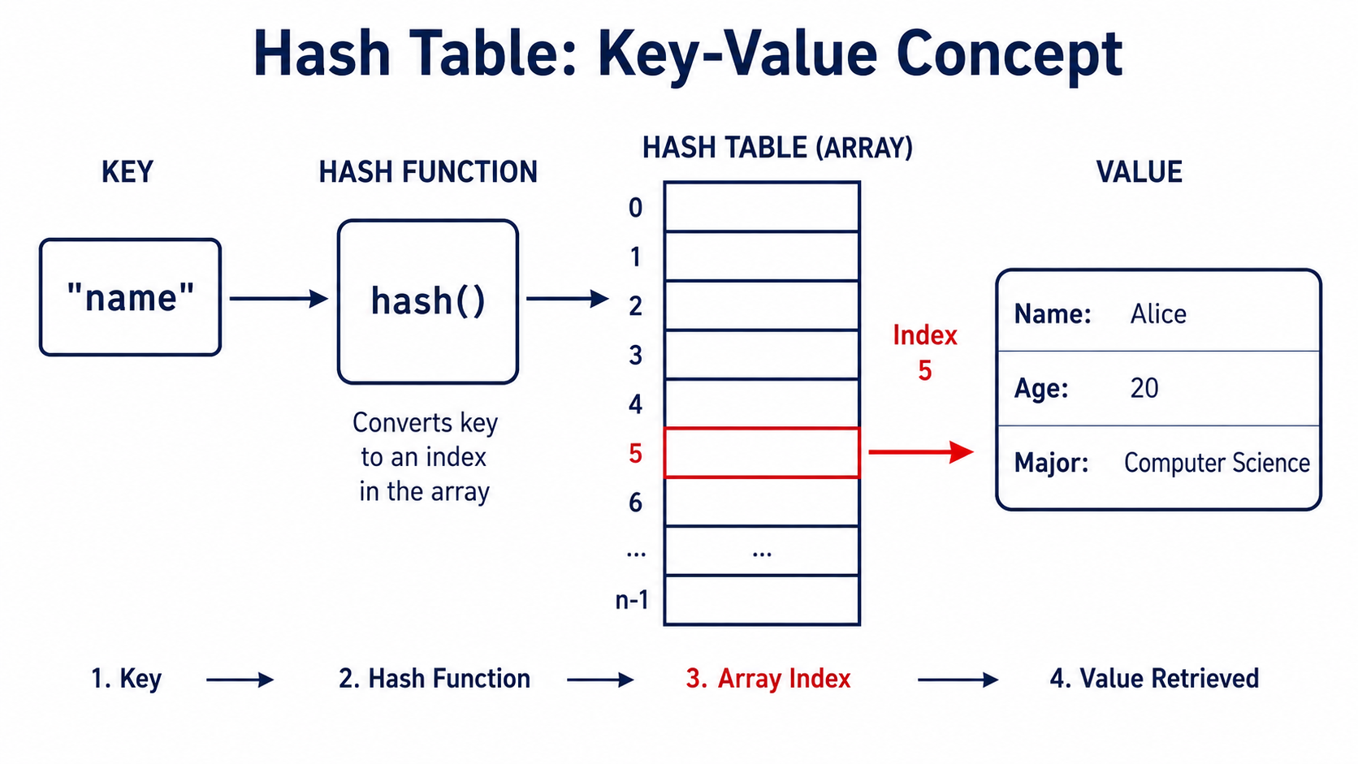
Key-Value Lookup in a Hash Table
• Key is passed to the hash function.
• Hash function calculates an array index.
• The calculated index is used to access the associated value.
Hashing
3

Slide 6
Why use hashing?
Fast Data Retrieval (Time Complexity: O(1))
  Hashing enables O(1) time complexity for search, insertion, and deletion in ideal conditions.
  A data structure that allows for the very fast retrieval of data no matter how much data there is.
  Hashing is an example of a space-time tradeoff.
    It uses extra memory to achieve faster data access.
Efficient Handling of Large Datasets
  Hashing distributes data evenly across a fixed-size table, enabling quick access.
  This prevents the need to search the entire dataset, improving efficiency.
      Avoiding Sequential / Linear Search / O(n)
Hashing
4

Slide 7
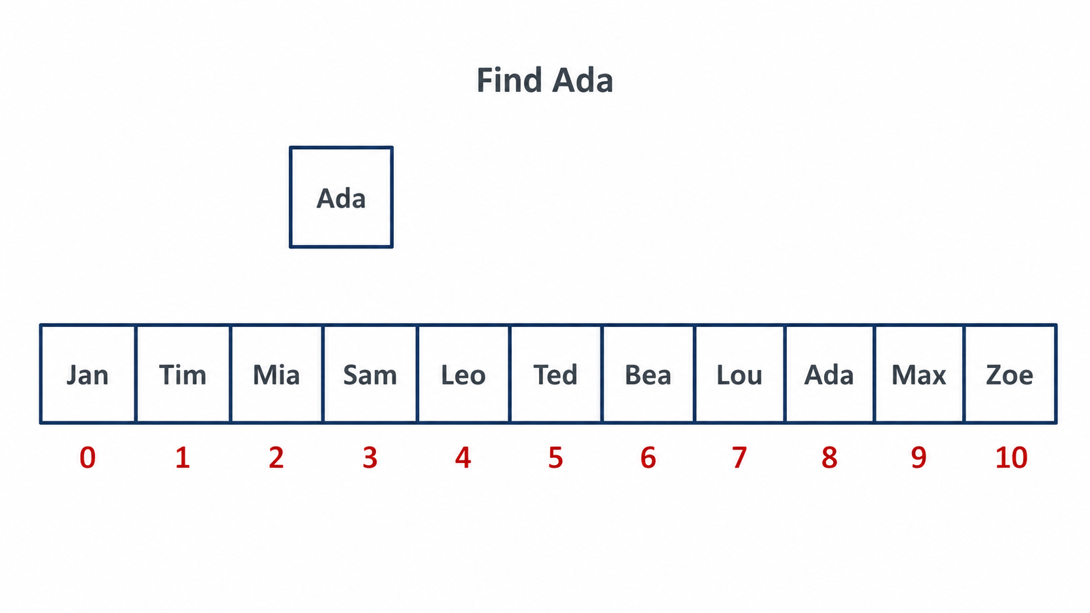
Demonstration of Hashing importance
In an Array:
If we do not know the index of the data,
we must search sequentially (Linear Search) to find the data (here, in this example, "Ada").
  In the worst case, the entire array may need to be traversed, resulting in a time complexity of O(n).
Therefore, for a very large array, searching can take a significant amount of time, O(n)
This motivates calculating an index from the key.
• Figure: Linear search is needed when the index is unknown.
Hashing
5

Slide 8
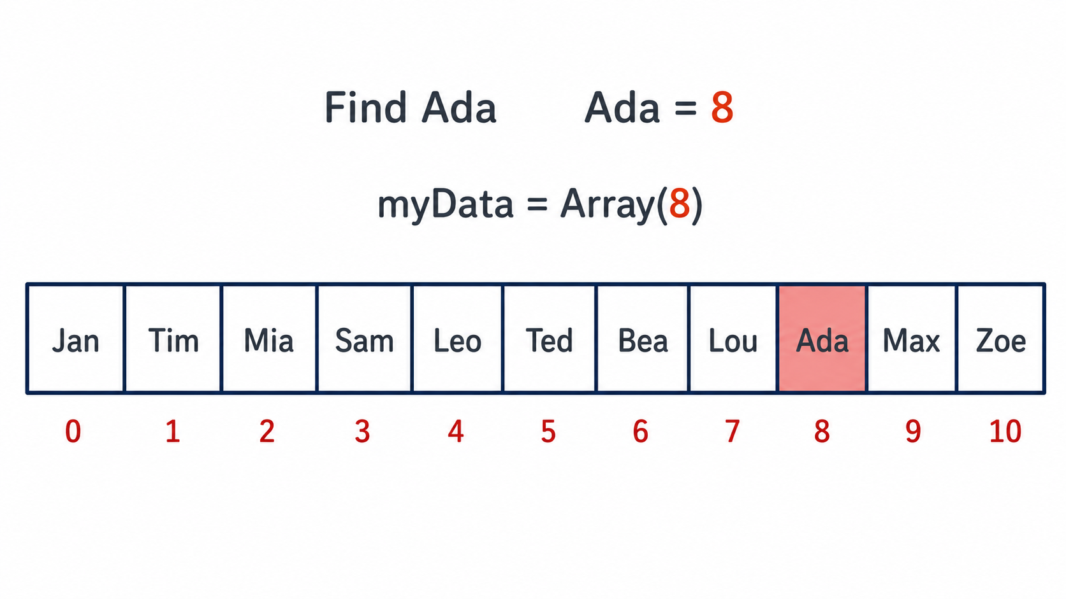
Demonstration of Hashing importance
If we know the index number of the data we are looking for, then the time it takes to access element is:
  ◦ Independent of the size of the Array
  ◦ Independent of the position of the element in the Array
  ◦ Data access time O(1).
  This is the main idea behind hashing.
• Figure: Direct access becomes possible when the index is known.
Hashing
6

Slide 9
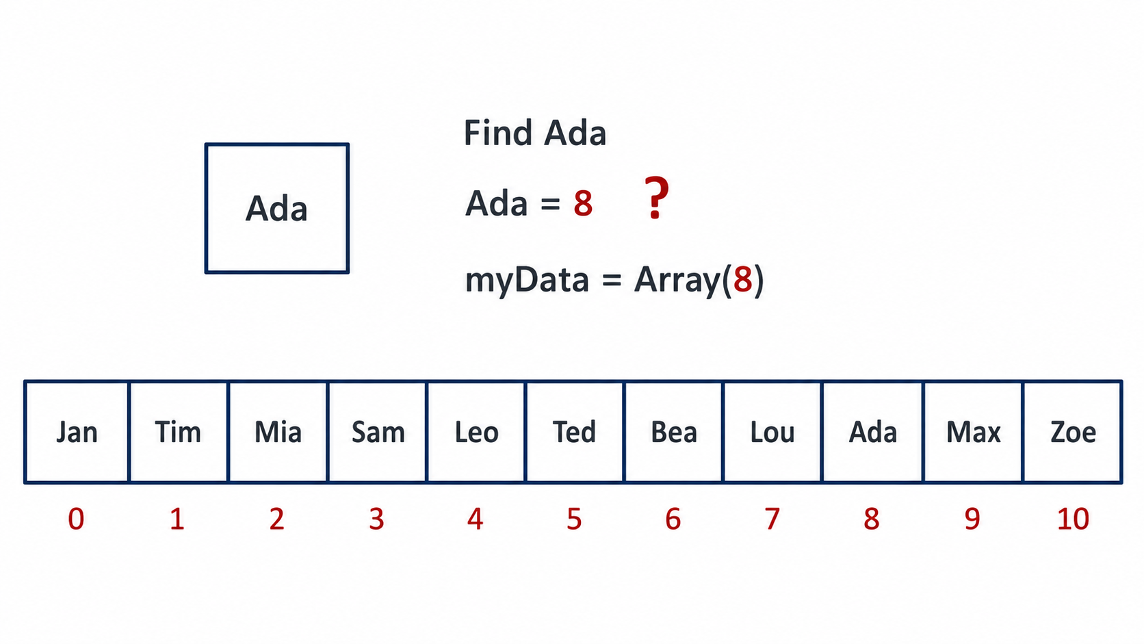
Demonstration of Hashing importance
Calculate the index from the data (key) itself
  Remembering the index of every data item is impractical.
  Instead, we calculate the index from the data (key) itself using a function.
  Thus, the index is directly derived from the key, eliminating the need for linear search.
    This allows data to be accessed efficiently,
    typically in O(1) average time.
• Figure: The index is derived from the key.
Hashing
7

Slide 10
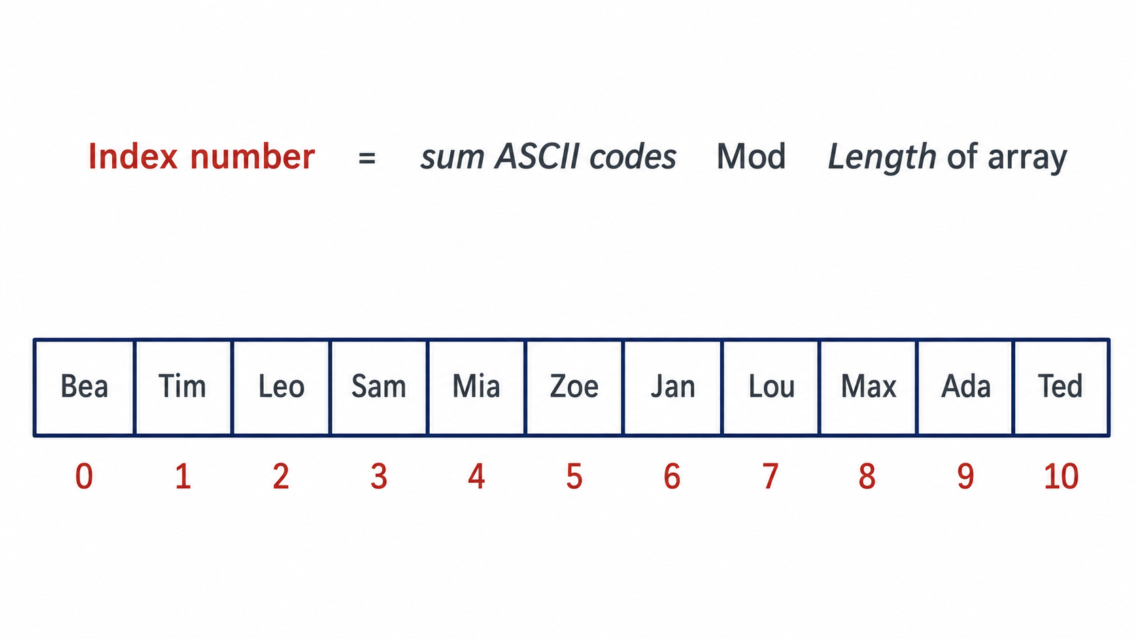
Demonstration of Hashing importance
• Process of calculating index number (the most basic one):
• Figure: Process of calculating index number
Hashing
7

Slide 11
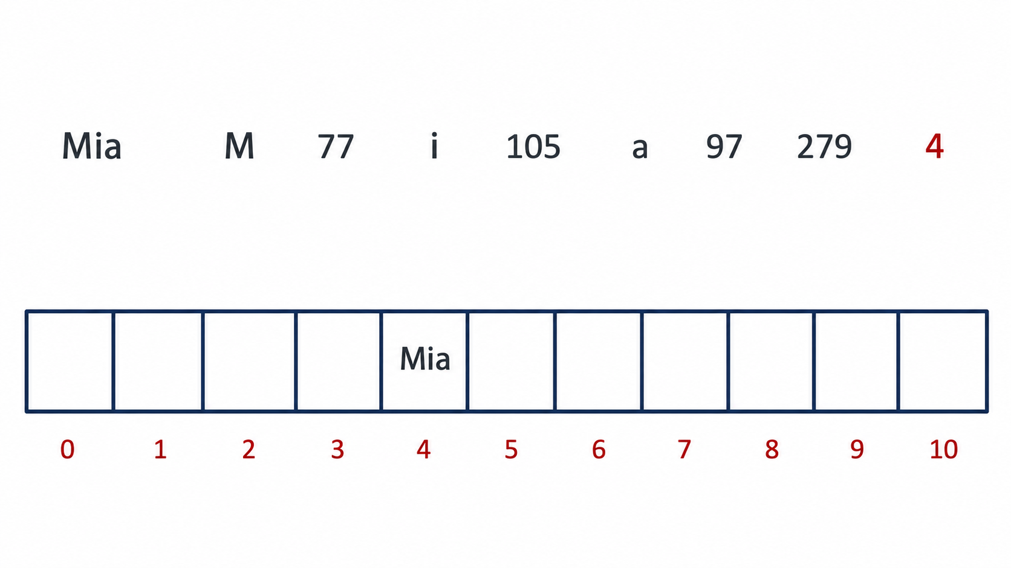
Demonstration of Hashing importance
Process of calculating index number (the most basic one):
  Sum up the ASCII codes and divide by the length of the Array = 11.
  The remainder 4 is the index.
• Figure: Remainder gives the index.
Hashing
8

Slide 12
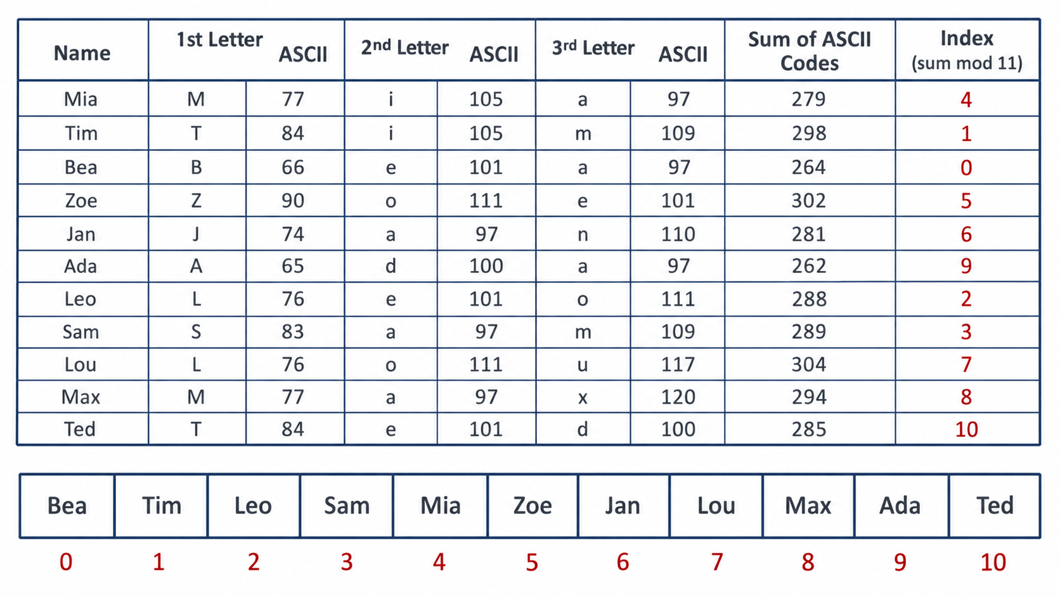
Demonstration of Hashing importance
• The indices for the rest of the elements could be calculated in the same way.
• Figure: Other keys can be indexed in the same way.
Hashing
8

Slide 13
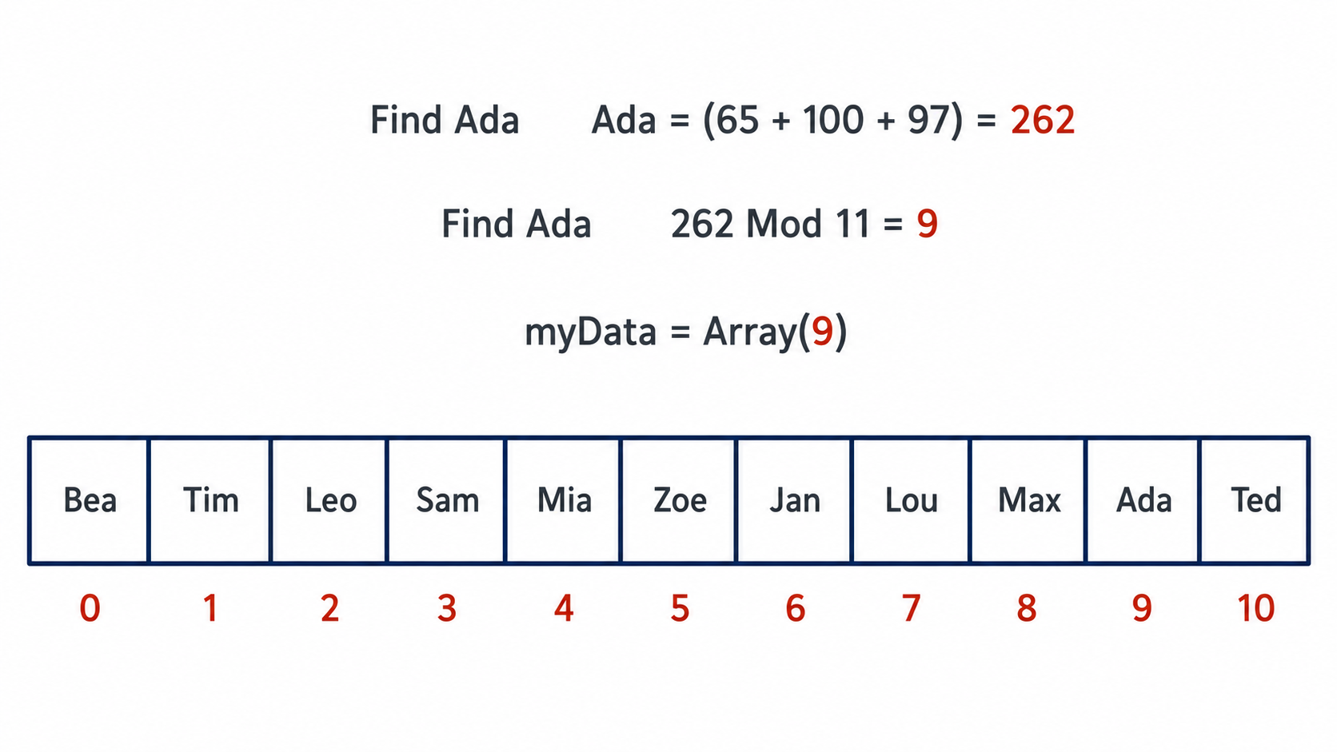
Demonstration of Hashing importance
• Retrieve the element / Key and Value
• Figure: The key can be used again to retrieve the element.
Hashing
9

Slide 14
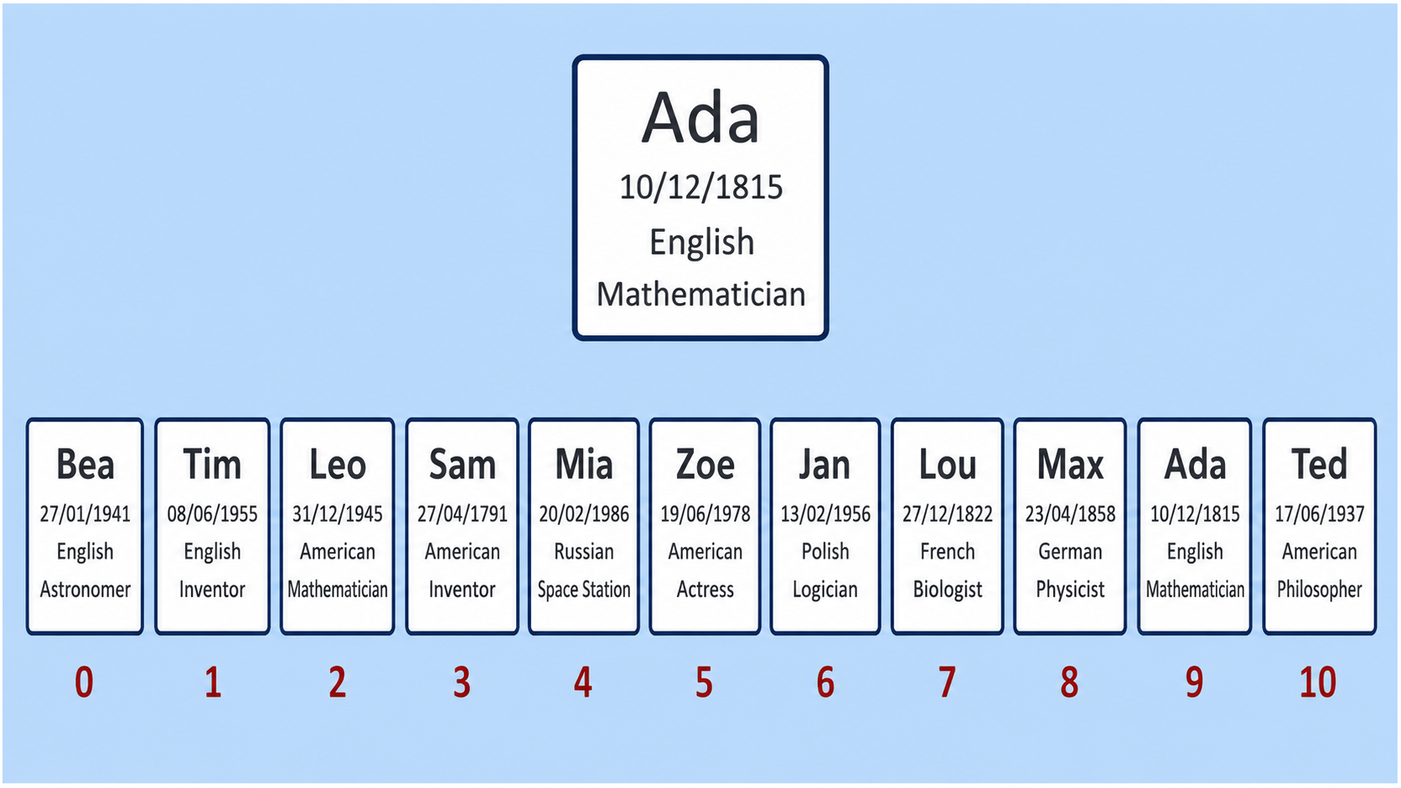
Key and Value in Hashing
• While using the name as a key for indexing, we can also keep other information.
• The key is used to locate and access its corresponding value.
  • Key: The part of the data used to calculate the hash index (array index).
  • Value: The remaining information associated with the key.
  In this example,
  • The name is used as the key.
  • Additional information is stored as the value.
Hashing
• Figure: Values can be stored together with their keys.
9

Slide 15
Important definitions
• Hash table: The array where both key and values are stored.
• Hashing Algorithm / Hashing Function:
It represents the calculations applied to a key which may be a very large number or a very large string to transform it into a relatively small index that corresponds to a position/index in a hash table.
The output, typically a number, is called the hash code or hash value.
  • This index number is effectively a memory address.
  • There is a lot of Hashing Algorithms to choose from.
Hashing
10

Slide 16
Objectives of hash function
• Objectives of Hash Algorithm / Hash Function:
  Easy to calculate
  Uniform distribution of hash values
  Minimize collision
  Resolve any collisions
Hashing
10

Slide 17
Possible ways of creating hash functions
Numeric keys:
  Divide the key by the number of available addresses, n (Length of hash table).
  Use the remainder as the address.
Address = Key mod n
= 42 mod 11 = 9
Alphanumeric keys:
  Add the ASCII codes of all characters in the key.
  Divide the sum by the number of available addresses, n (Length of hash table).
  Use the remainder as the address.
  Address = (Sum of the ASCII codes of all characters in the key) mod n
  = (ASCII("C")+ASCII("A")+ASCII("T")) mod 11
  = (67+65+84) mod 11
  = 216 mod 11
  = 7
Hashing
11

Slide 18
Possible ways of creating hash functions
Folding method:
  Divide the key into equal-sized parts.
  Add the parts together.
  Depending on the table size, divide the result by a constant and use the remainder.
  Example:
  Key: 12345678
      Divide the key into equal-sized parts: 12 | 34 | 56 | 78
      Add the parts: 12 + 34 + 56 + 78 = 180
      For a hash table of size 11: 180 mod 11 = 4
      Final address/index: 4
Hashing
11

Slide 19
Why Do We Use mod with the Hash Table Size?
For a hash table of length n, the valid indices are 0 to n − 1.
Using index = key mod n
    Always produces a remainder in the range 0 to n − 1.
So, even a very large key is converted into a valid array index.
Example:
  If n = 10, then
  12347 mod 10 = 7,
  So, the item is stored at index 7.
Valid indices for length 10
0 1 2 3 4 5 6 7 8 9
Important note
Always modding with the hash table length is not enough;
you also need to check
how the hash function is working and
whether it distributes the given keys well.
Hashing
1

Slide 20
What Happens If a Smaller Divisor Is Used?
• Suppose, the hash table length is 10, but the hash function uses key mod 5.
• Then the possible indices are only 0, 1, 2, 3, and 4.
• Indices 5 to 9 will never be used.
• So, only half of the table is used and the number of collisions increases.
The same problem happens if any number smaller than n is used for modding.
Key | key mod 10 | key mod 5
0 | 0 | 0
1 | 1 | 1
2 | 2 | 2
3 | 3 | 3
4 | 4 | 4
5 | 5 | 0
6 | 6 | 1
7 | 7 | 2
8 | 8 | 3
9 | 9 | 4
Hashing
2

Slide 21
Hashing Theory Sample Question
A hash table of size 10 is used to store the following keys: 15, 25, 35, 45, 55, 65, 75.
Assume forward chaining will be used for collision handling. The following four hash functions are proposed:
    H1(k) = k mod 10
    H2(k) = (k / 10) mod 10
    H3(k) = (k + 5) mod 10
    H4(k) = (k × 2) mod 10
Which hash function is the best choice here to reduce collision?
Note: All the results will be in integer; if there are fractions, the floor value is considered.
Answer options: (a) H1 (b) H2 (c) H3 (d) H4
Hashing
3

Slide 22
Working Out the Four Hash Functions
Key | H1: k mod 10 | H2: (k/10) mod 10 | H3: (k+5) mod 10 | H4: (k×2) mod 10
15 | 5 | 1 | 0 | 0
25 | 5 | 2 | 0 | 0
35 | 5 | 3 | 0 | 0
45 | 5 | 4 | 0 | 0
55 | 5 | 5 | 0 | 0
65 | 5 | 6 | 0 | 0
75 | 5 | 7 | 0 | 0
• H1: all keys go to index 5 → worst collision.
• H2: keys go to 1, 2, 3, 4, 5, 6, 7 → no collision.
• H3: all keys go to index 0 → worst collision.
• H4: all keys go to index 0 → worst collision.
Hashing
4

Slide 23
Working Out the Four Hash Functions
Key | H1: k mod 10 | H2: (k/10) mod 10 | H3: (k+5) mod 10 | H4: (k×2) mod 10
15 | 5 | 1 | 0 | 0
25 | 5 | 2 | 0 | 0
35 | 5 | 3 | 0 | 0
45 | 5 | 4 | 0 | 0
55 | 5 | 5 | 0 | 0
65 | 5 | 6 | 0 | 0
75 | 5 | 7 | 0 | 0
Final Answer: (b) H2
Best choice: H2(k) = (k / 10) mod 10
  Reason:
    Each key produces a different index, so collisions are minimized.
    H1, H3, and H4 all create very poor distributions for this particular set of keys.
Hashing
4

Slide 24
Key Takeaway from the Previous Example
Using mod n keeps the index within the valid range.
However, it does not guarantee an even distribution of keys.
The hash function must be evaluated based on:
How evenly/uniformly it distributes the given keys
How effectively it minimizes collisions
Hashing
5

Slide 25
Collisions
Sometimes a hash function applied to different keys could generate the same index number different keys However, multiple items cannot be stored in the same place.
Different keys
Same bucket index
cat
hash
function
0
1
2
3
4
rat
Both cannot occupy the same single array location without a strategy.
Hashing
12

Slide 26
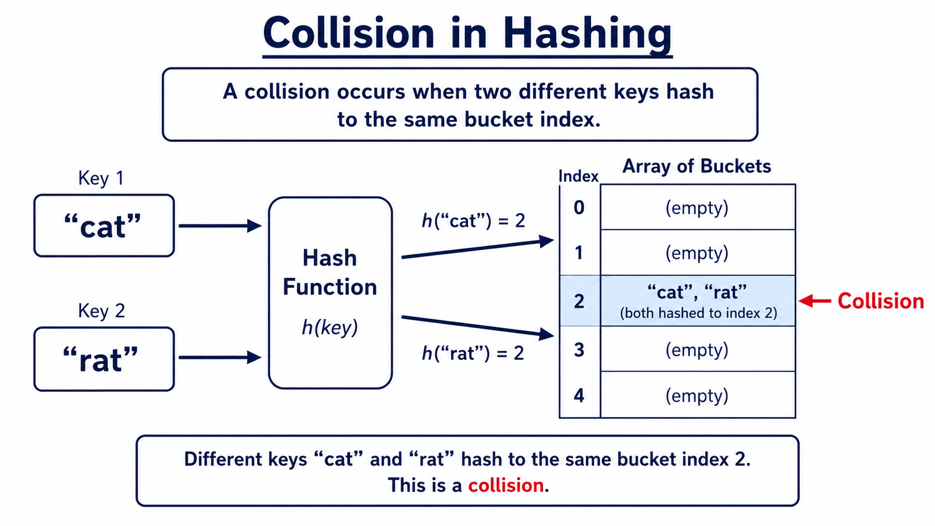
Collision in Hashing
• A collision happens when different keys produce the same index.
• Both values cannot occupy the same single array slot without a strategy.
• Therefore, Collision handling is required.

Slide 27
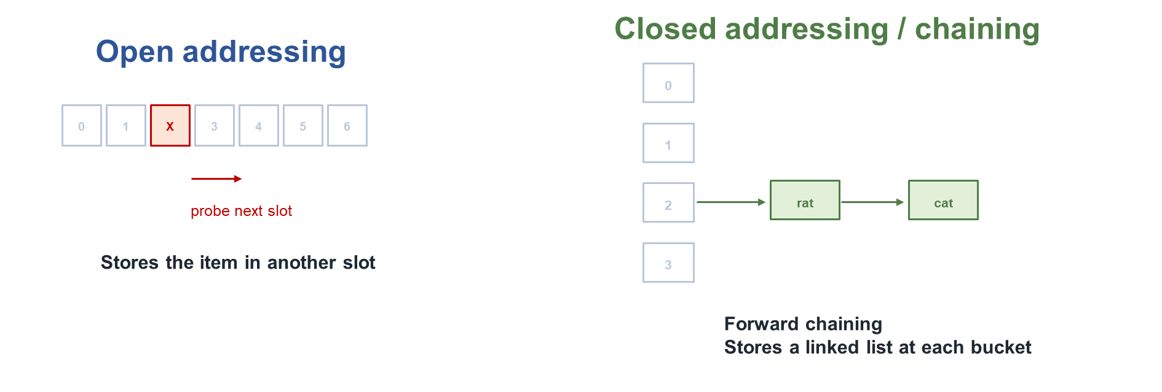
Solutions for handling collisions
Open addressing (Solution of collision removal: Linear probing, double hashing, etc)
Closed addressing (Solution of collision removal: Forward chaining)
Hashing
12

Slide 28
Open addressing (Optional)
Resolving a collision by placing an item somewhere other than its calculated address.
This process is called open address because every location is opened to any other item.
Open addressing can use a variety of techniques to decide where to place an item that does not go where it should.
  Linear probing
  Double hashing
Hashing
13

Slide 29
Open addressing : Linear probing (Optional)
If the calculated address is occupied, then a linear search is used to find the next available place.
If linear probing gets to the end of the array, and it still cannot find a free place,
    It might cycle around to the beginning of the Array and continue searching from there.
    (Circular array concept)
Hashing
13

Slide 30
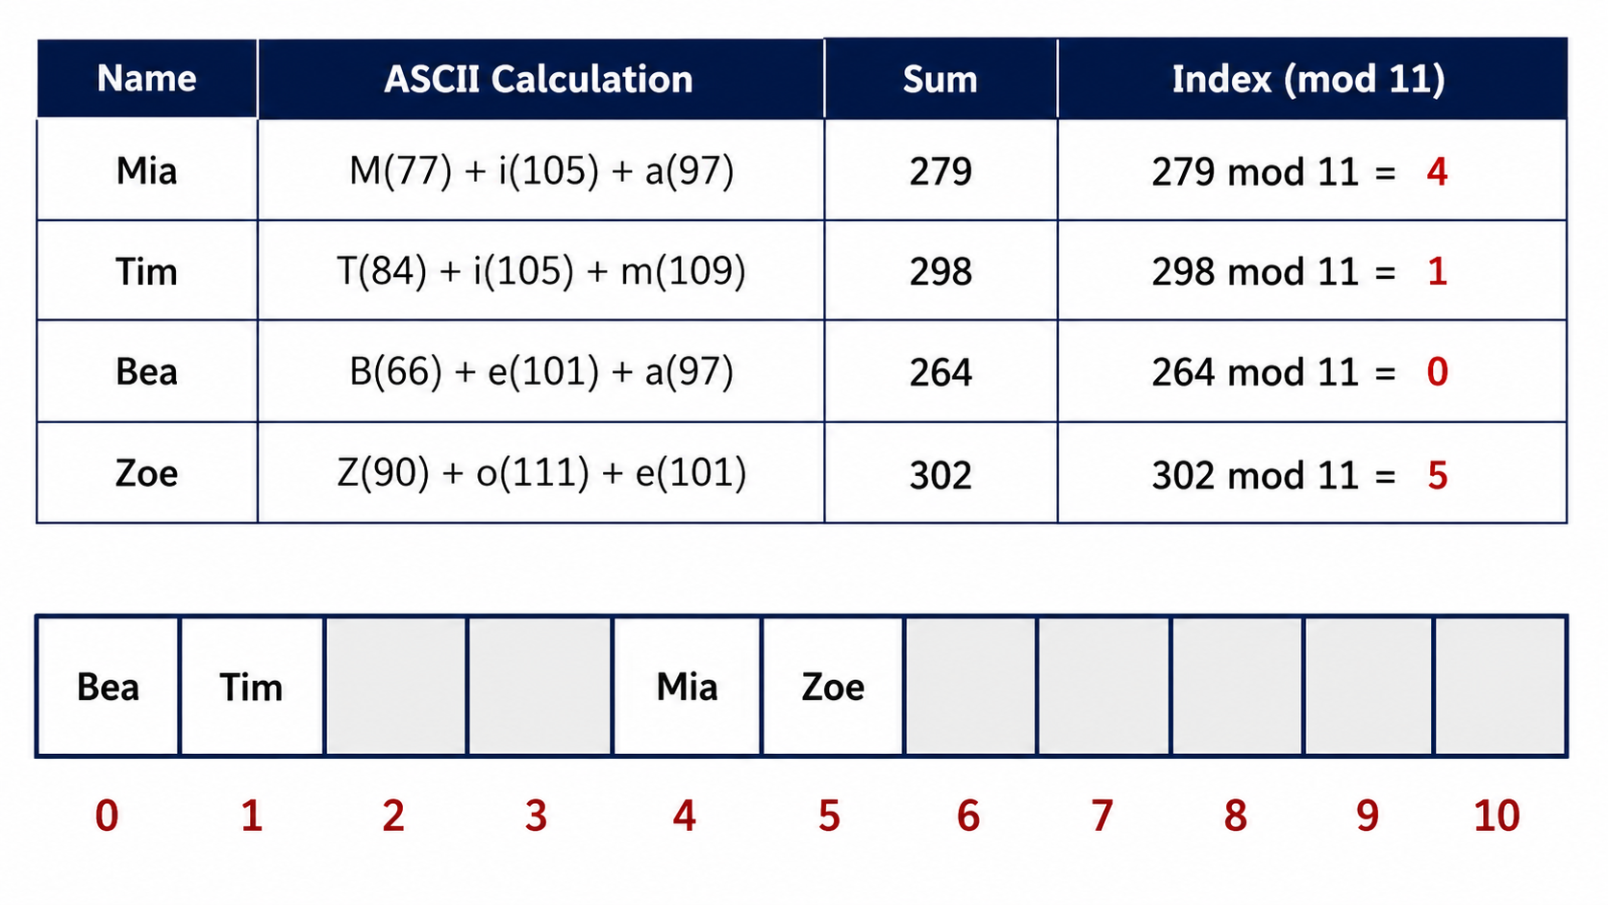
Open addressing : Linear probing (Optional)
◦ Initial state before collision.
Hashing
13

Slide 31
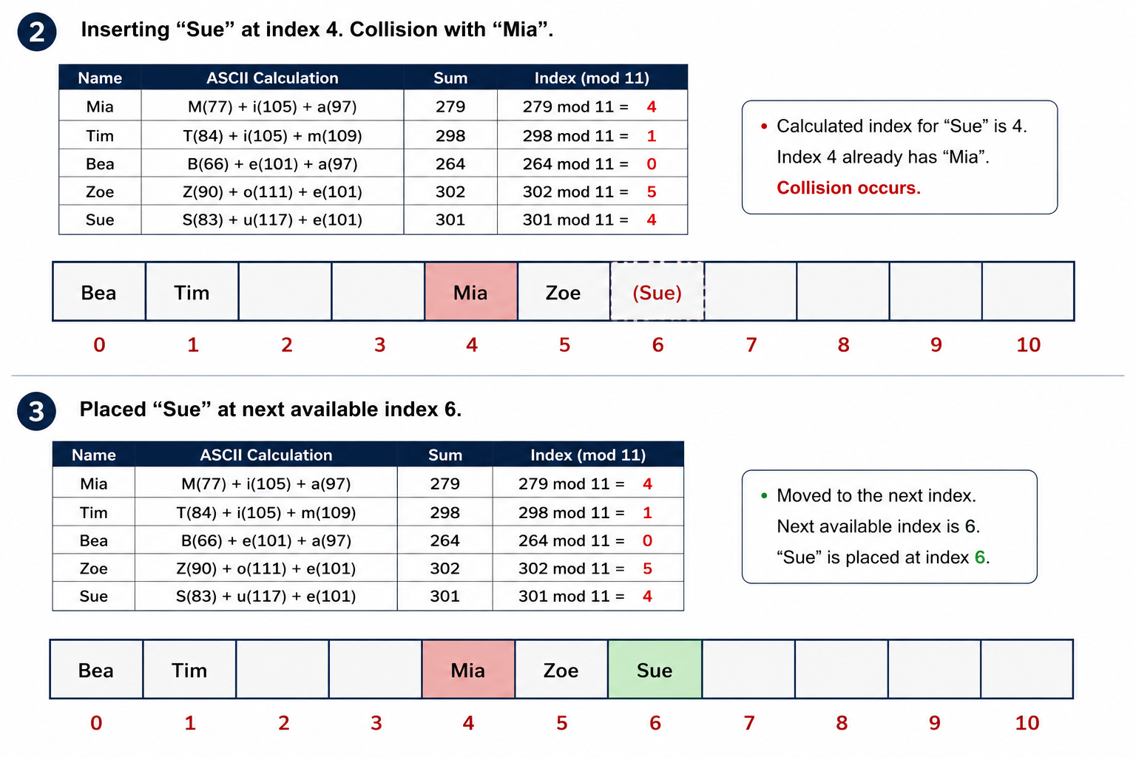
Linear probing steps: Insert Sue
Hashing
14

Slide 32
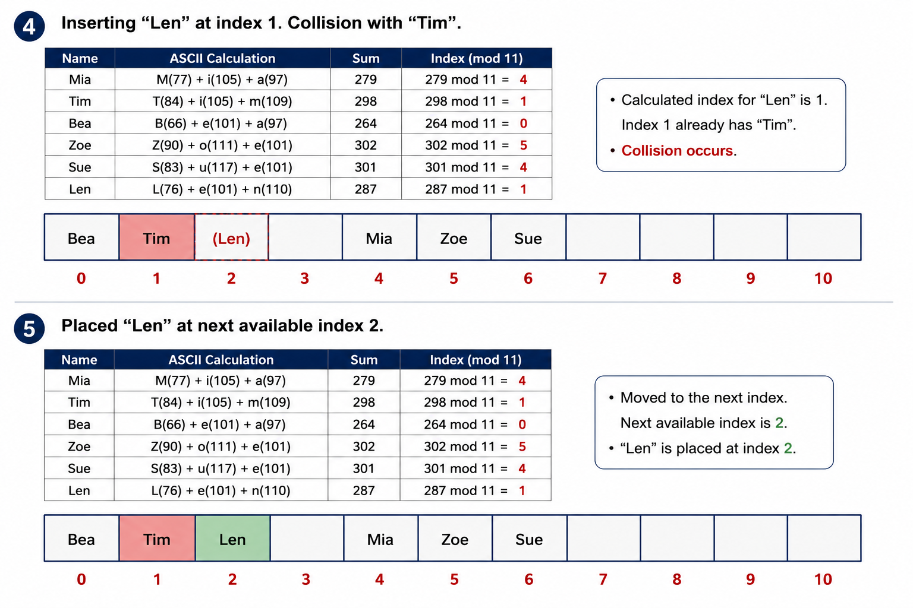
Linear probing steps: Insert Len
Hashing
15

Slide 33
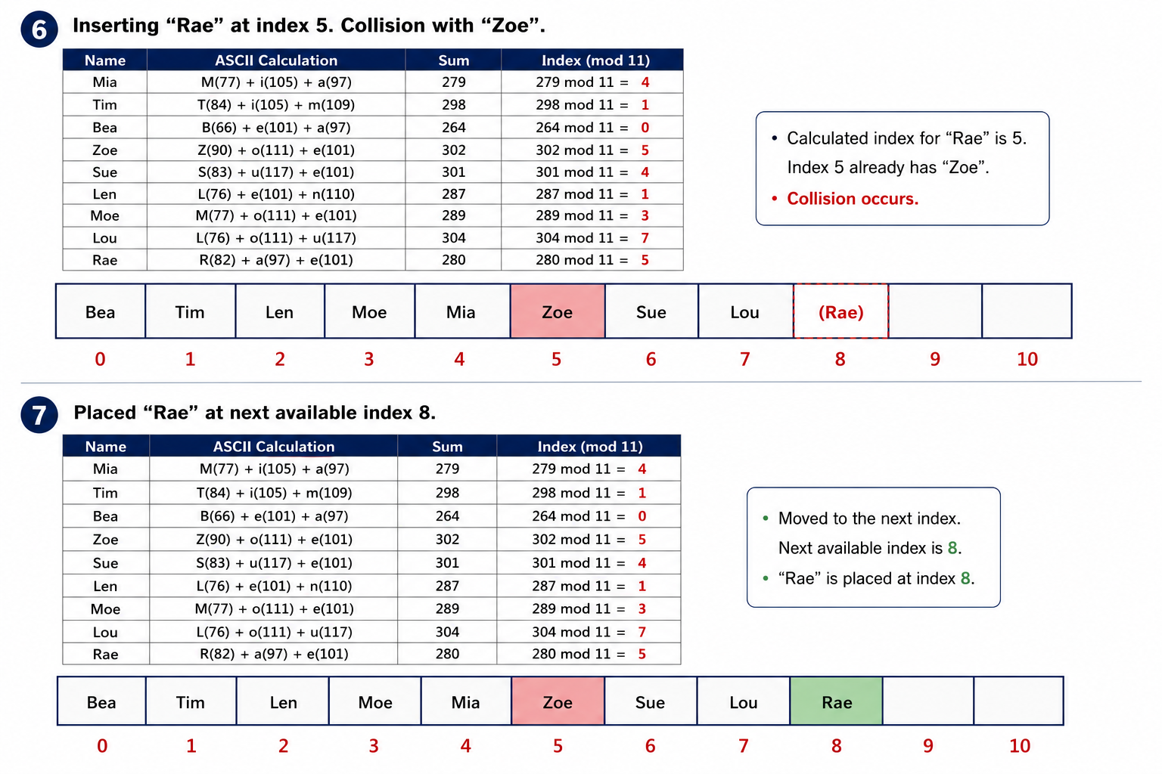
Linear probing steps: Insert Rae

Slide 34
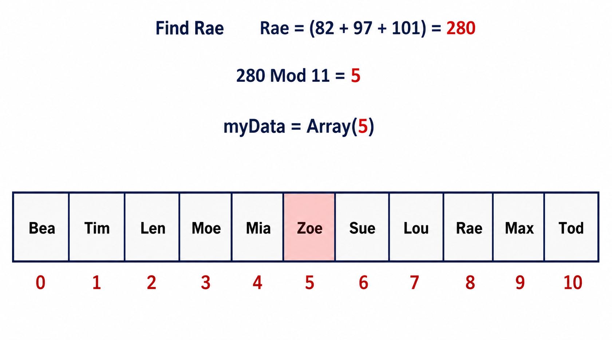
Problem with linear probing
Increases chance of collision.
To lookup an item in the hash table, hashing function is applied again.
If there is a collision and the item is not in the calculated position,
  Then finding an item would also involve linear probing,
  That is a linear search, O(n), which we are trying to avoid
• Figure: Finding Rae again may require a linear search.
Hashing
17

Slide 35
Problem with linear probing
We do not use linear probing due to this issue.
    Forward chaining solves this issue.
    (One of the popular methods)
In the figure here,
  Instead of index-5, Rae is in index-8.
  We will need to do linear search to find Rae in index 8.
• Figure: Finding Rae again may require a linear search.
Hashing
17

Slide 36
Double hashing (Optional, skip)
Better than linear probing because it reduces clustering.
Uses a second hash function when a collision occurs.
  The first hash function determines the initial index.
  The second hash function determines the step size or jump distance used to find another index.
Hashing
18

Slide 37
Load factor (Optional, skip)
◦ The load factor is a measure of how full a hash table is.
Load factor = number of items / total number of slots
◦ For the example below,
Number of slots = 5
Number of items = 7
So, load factor = 7/5 = 1.4 (on average, each slot stores 1.4 items)
Hashing
18

Slide 38
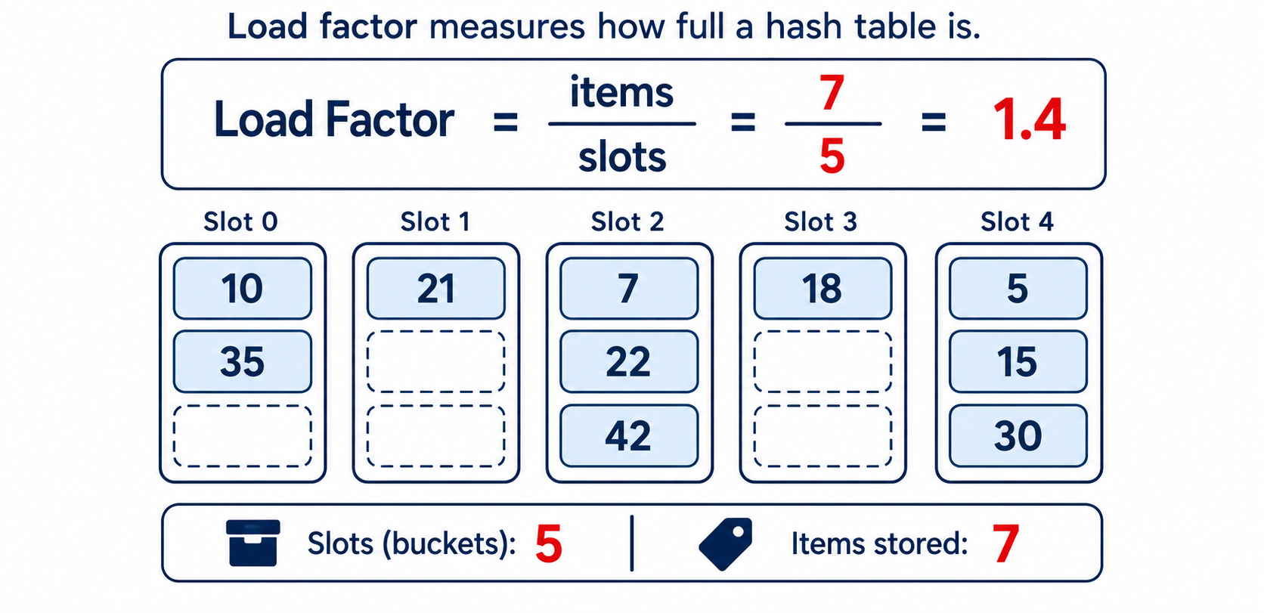
Load factor (Optional, skip)
In forward chaining, the load factor can be greater than 1.
A lower load factor generally reduces collisions and improves performance.
Ideal is to have 1. (No collisions)
Hashing
18

Slide 39
Closed addressing: Forward chaining (Important!!!!)
• Forward Chaining:
◦ Forward chaining stores a linked list at each index.
◦ It effectively handles collisions in a hash table, ensuring no key-value pairs are overwritten or lost.
Collision is handled inside the original bucket; no key-value pair is overwritten.
Hashing
19

Slide 40
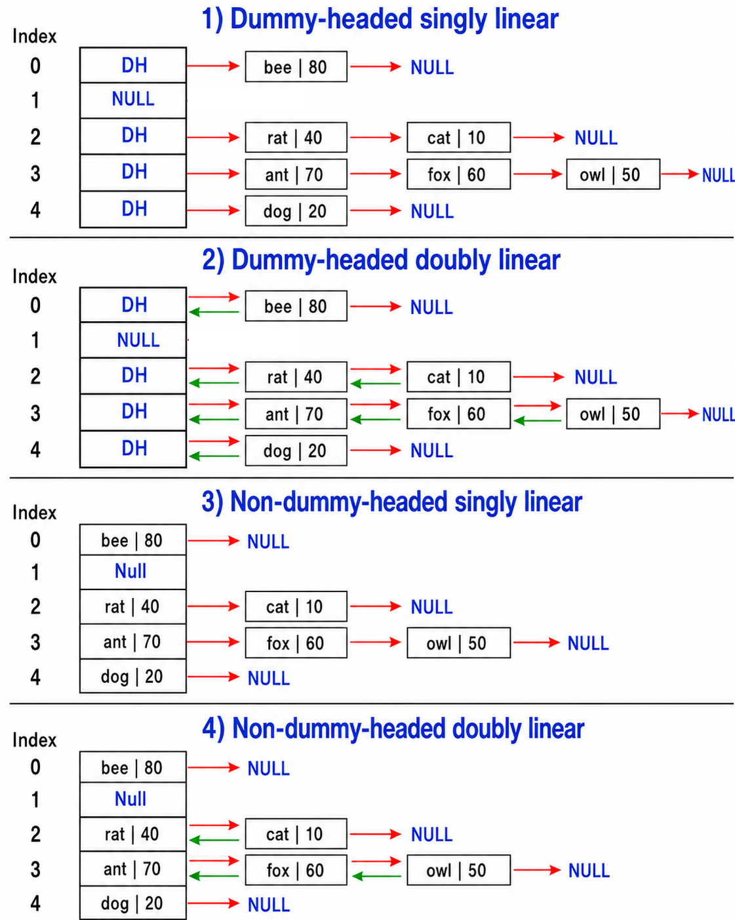
Which type of linked list can be used
• Any type of linear linked list can be used for hashing.
• Dummy-headed singly linear
• Dummy-headed doubly linear
• Non-dummy-headed singly linear
• Non-dummy-headed doubly linear
Hashing
• Figure: Linear linked-list choices for hashing.
22

Slide 41
Why Singly Dummy-Headed Linked Lists Are Preferable in Hash Tables
Dummy vs non-dummy head:
  In a dummy-headed linked list, the head reference stored in the hash table slot remains unchanged even when insertion at index 0 or prepend is performed.
      However, this requires one extra dummy node, increasing space usage slightly.
  In a non-dummy linked list, the head reference changes whenever a new node is inserted at the beginning.
    Since the head reference represents the entire chain, frequent changes to the head can be less convenient and more error-prone.
Therefore, for hash table chaining,
dummy-headed linked list is convenient
Hashing
23

Slide 42
Why Singly Dummy-Headed Linked Lists Are Preferable in Hash Tables
Singly vs doubly:
  For hash table operations such as search and deletion, the key is used to compute the hash index.
      Then traversal starts from the first data node and continues forward until null.
  Since traversal is always forward,
      The previous pointer in a doubly linked list is unnecessary
      Only increases memory usage.
Therefore, for hash table chaining,
a singly linked list is generally more space-efficient than a doubly linked list.
Hashing
23

Slide 43
Why Singly Dummy-Headed Linked Lists Are Preferable in Hash Tables
• Preferred for hashing: Dummy-headed singly linked list
• Stable head reference
• Convenient prepend operation
• No unnecessary previous pointer
Hashing
23

Slide 44
Which type of linked list can be used (Summary)
Choice
Advantage
Limitation
Dummy-headed list
Bucket reference remains stable during prepend.
Uses one extra dummy node.
Non-dummy-headed list
No dummy node overhead.
Head changes during prepend; can be more error-prone.
Singly linked list
Forward traversal is enough; less memory.
Cannot move backward.
Doubly linked list
Supports backward movement.
Previous pointer is unnecessary for typical hash-table operations.
22
Hashing

Slide 45
For Hashing Questions in Exams
For question-setting purposes, any type of linked list may be used, including:
      Linear or Circular
      Dummy-Headed or Non-Dummy-Headed
      Singly or Doubly Linked
Hashing
20

Slide 46
Forward chaining operations
Insertion:
  Prepend the new key-value pair to the linked list at the calculated index.
  Ensuring O(1) constant-time insertion.
Search:
  Traverse the linked list at the calculated index to find the key.
  Search time increases with the number of collisions.
Update:
  Find the key in the linked list and replace its existing value.
  Search/finding time increases with the number of collisions.
Delete/Remove:
  Find the target node and update the predecessor’s link to bypass it.
Hashing
20

Slide 47
Forward chaining operations
Method | Purpose | Return | Complexity
hash_function(key) | Calculate the bucket index. | Integer index | Depends on function
insert(key, value) | Insert a key-value pair; prepend on collision. | None | O(1)
search(key) | Find whether a key exists in its chain. | True/False | O(k) in LL chain
update(key, value) | Replace the value of an existing key. | None / status | O(k) in LL chain
remove(key) | Delete the matching node by bypassing it. | None / status | O(k) in LL chain
k = number of nodes in one chain
bucket
1
2
k
Good hash functions keep k small by distributing keys evenly.
Hashing
20

Slide 48
Deletion and Search Complexity
When k keys hash to the same slot/index, deletion and search take Θ(k) time, which is linear to the length of the linked list.
In the worst case, all keys may be stored in one slot instead of being uniformly/evenly distributed.
  Therefore, search() and remove()/delete() may need to traverse up to n nodes
    Making their worst-case time complexity O(n).
Therefore, selecting a good hash function to minimize collisions is crucial.
Hashing
21

Slide 49
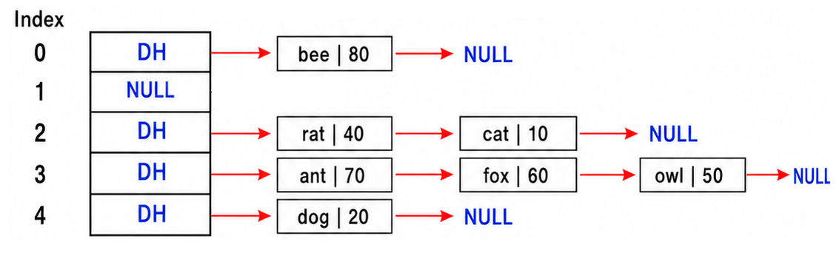
Java Code: Forward Chaining Using Dummy-Headed Singly Linked List
class Node {
String key; (extra)
int value;
Node next;
public Node(String key, int value) {
this.key = key;
this.value = value;
this.next = null;
}
}
Hashing
25

Slide 50
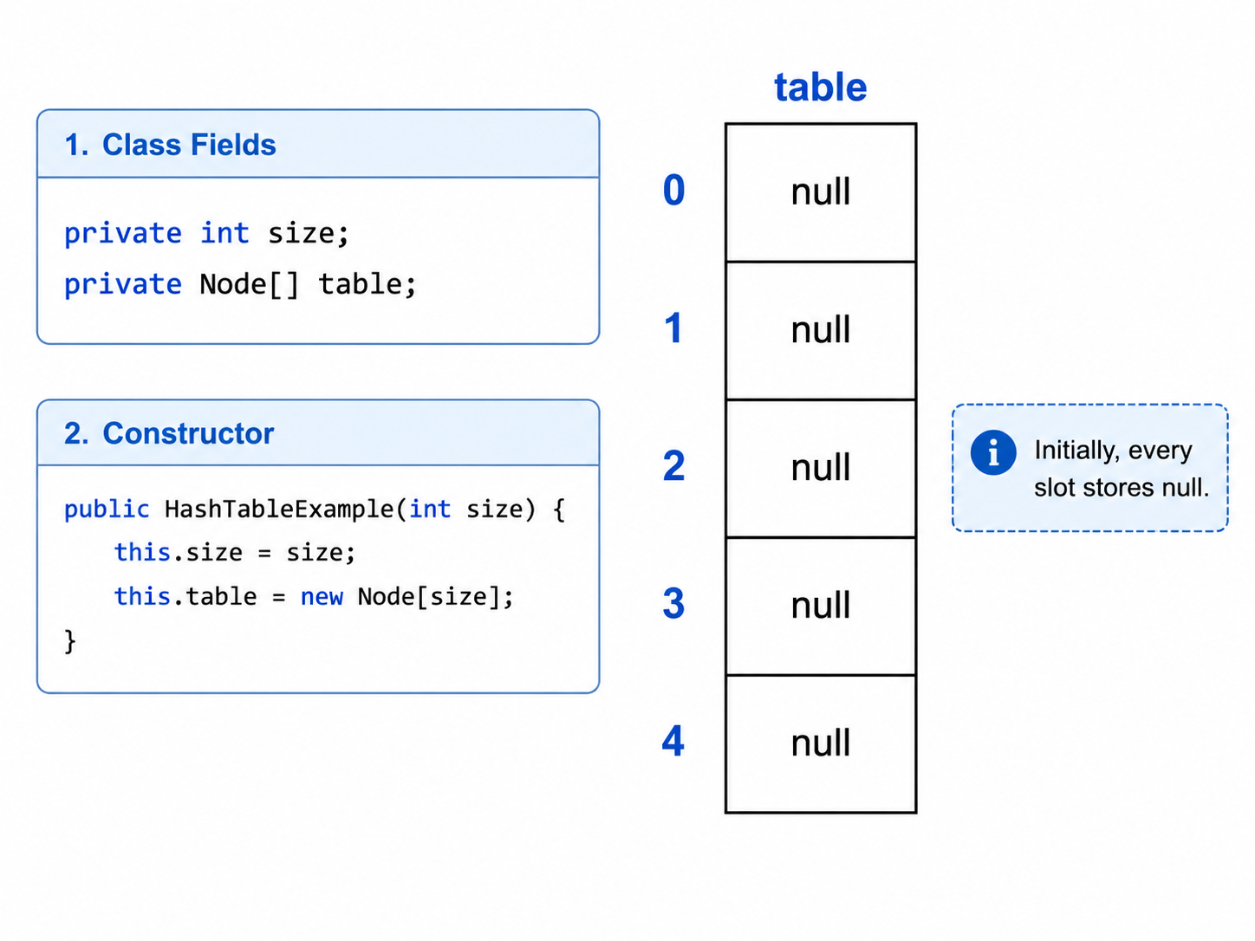
Java Code: Forward Chaining Using Dummy-Headed Singly Linked List
class HashTableExample {
private int size;
private Node[] table;
public HashTableExample(int size) {
this.size = size;
this.table = new Node[size];
}
Hashing
25

Slide 51
Java Code: Forward Chaining Using Dummy-Headed Singly Linked List
private int hashFunction(String key) {
int hashValue = 0;
for (int i = 0; i < key.length(); i++) {
hashValue += key.charAt(i);
}
return hashValue % size;
}
Hashing
25

Slide 52
Java Code: Forward Chaining Using Dummy-Headed Singly Linked List
private int hashFunction(String key) {
int hashValue = 0;
for (int i = 0; i < key.length(); i++) {
hashValue += key.charAt(i);
}
return hashValue % size;
}
Table size = 5;
hash index = sum of ASCII character codes % 5.
Key | Character ASCII sum | Calculation | Bucket
cat | 312 | 312 % 5 | 2
rat | 327 | 327 % 5 | 2
dog | 314 | 314 % 5 | 4
owl | 338 | 338 % 5 | 3
fox | 333 | 333 % 5 | 3
ant | 323 | 323 % 5 | 3
bee | 300 | 300 % 5 | 0
Hashing
25

Slide 53
Java Code: Forward Chaining Using Dummy-Headed Singly Linked List
public void insert(String key, int value) {
int index = hashFunction(key);
if (table[index] == null) {
table[index] = new Node(null, -1); // Dummy head node, key is null, value is -1
}
// Prepend after dummy head
Node newNode = new Node(key, value);
Node predecessor = table[index]; // Predecessor is dummy head
Node successor = predecessor.next;
newNode.next = successor; // Link the successor
predecessor.next = newNode; // Link the predecessor
}
Hashing
25

Slide 54
Java Code: Forward Chaining Using Dummy-Headed Singly Linked List
public boolean search(String key) {
int index = hashFunction(key);
if (table[index] == null) {//no chain to search
return false;
}
Node current = table[index].next; // Starting after dummy head
while (current != null) { // Going till tail
if (current.key == key) { // If key matches, return true
return true;
}
current = current.next; // Move to the next node
}
return false; // If the key is not found
}
Hashing
25

Slide 55
Java Code: Forward Chaining Using Dummy-Headed Singly Linked List
public boolean update(String key, int newValue) {
int index = hashFunction(key);
if (table[index] == null) { // No chain to search
return false;
}
Node current = table[index].next; // Start after the dummy head
while (current != null) { // Traverse until the tail
if (current.key.equals(key)) { // If the key matches
current.value = newValue; // Update the value
return true;
}
current = current.next; // Move to the next node
}
return false; // Key was not found
}
Hashing
25

Slide 56
Java Code: Forward Chaining Using Dummy-Headed Singly Linked List
public void remove(String remKey) {
int index = hashFunction(remKey);
if (table[index] == null) {
System.out.println("Key '" + remKey + "' not found.");
return;
}
Node predecessor = table[index]; // Predecessor (head node), i = 0
Node remNode = predecessor.next; // Node to be removed (remNode), j = i+1
while (remNode != null) {
if (remNode.key.equals(remKey)) { // Found the node to remove
Node successor = remNode.next; // The node after remNode
predecessor.next = successor; // Bypass remNode
System.out.println("Removed (" + remNode.key + ", " + remNode.value + ")");
return;
}
predecessor = remNode; // Move predecessor forward, i++
remNode = remNode.next; // Move remNode forward, j++
}
System.out.println("Key '" + remKey + "' not found.");
}
Hashing
25

Slide 57
Key Points to Remember
Hash tables store key-value pairs and use a hash function to calculate an array index (hash value).
Average search, insertion, and deletion can be O(1) when keys are well distributed and collisions are limited.
  In forward chaining, prepend insertion takes O(1).
  Search, update and deletion within a chain take O(k), where k is the number of nodes in that chain.
  The worst-case time complexity is O(n) when all keys fall into one bucket.
A collision occurs when different keys produce the same index.
  Linear probing stores the item in another array slot.
  Forward chaining stores collided items in a linked list at the original index.
A dummy-headed singly linked list is generally preferable because:
  The head reference remains stable.
  No unnecessary previous pointer is required.
Hashing
26

Slide 58
REMEMBER!!!
Good hash function + low collisions = fast access
Hashing
26

Slide 59
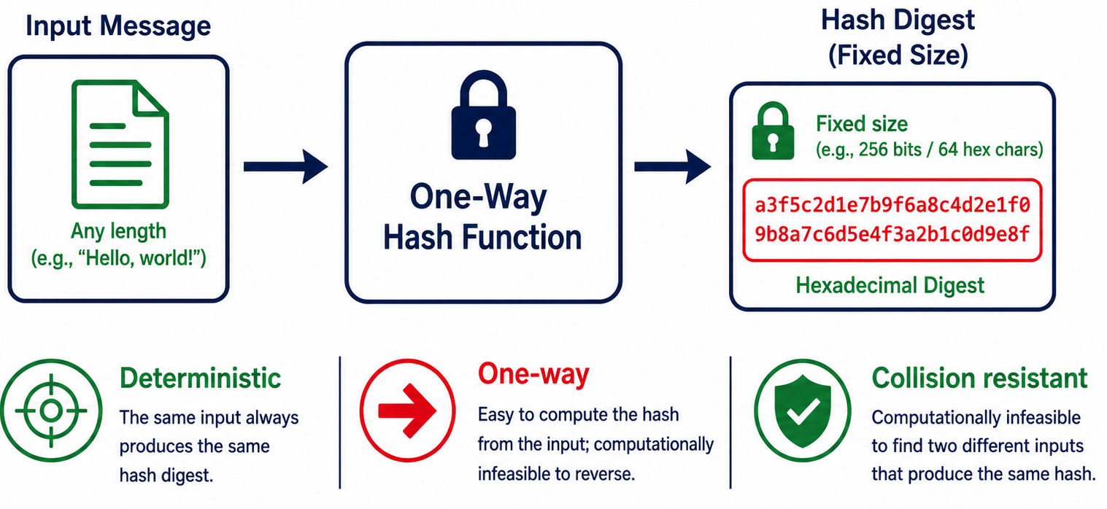
Cryptographic Hashing (Optional, skip)
Fundamental concept in computer science and cryptography.
It is a mathematical function that takes an input (or "message") of arbitrary size and produces a fixed-size string of characters,
  Typically represented in hexadecimal format.
This fixed-size output is often referred to as the hash value, hash code, or simply hash.
Hashing
26

Slide 60
Cryptographic Hashing (Optional, skip)
Key properties of cryptographic hashing functions are:
Deterministic: For a given input, the hash function always produces the same output. This property is crucial for consistency and predictability.
Irreversibility (One-way): The hash function is designed to be irreversible, meaning it should be computationally infeasible to derive the original input from its hash value. This property ensures that the original data remains secure even if the hash is known.
Collision resistance: It should be extremely difficult to find two different inputs that produce the same hash value. In other words, it should be computationally infeasible to create a collision intentionally.
Hashing
26

Slide 61
Applications of Cryptographic hashing (Optional, skip)
Numerous applications in information security and computer science, including but not limited to:
Password storage: Storing passwords securely by hashing them, preventing direct exposure of user passwords in databases.
Data integrity verification: Verifying that data has not been tampered with by comparing the hash of the original data with the computed hash of the received data.
Digital signatures: Used in digital signature algorithms to ensure authenticity and integrity of messages or documents.
Secure storage and retrieval: Employed in blockchain technology to create secure links between blocks of data.
Hashing
26

Slide 62
Common Cryptographic Hashing Algorithms (Optional, skip)
MD5: Message Digest Algorithm 5
SHA-1: Secure Hash Algorithm 1
SHA-256: Part of the SHA-2 family
SHA-3: A newer Secure Hash Algorithm standard
Older hashing algorithms may become less secure as:
  Computing power increases
  New cryptographic vulnerabilities are discovered
Use the most current and secure hashing algorithm available.
Hashing
26

Slide 63
The End
Hashing
26

